Slide 1


School of Basic and Applied Sciences
Course Code : BBS01T1002 Course Name: Semiconductor Physics
Energy Bands in solids
Name of the Faculty: Dr. Aakash Mathur Program Name: B.Tech

Slide 2
Topics to be covered
:
Preliminary ideas of Schrodinger equation and Bloch Theorem
Introduction
Kronig Penney Model
Energy bands in solids
Classification of solids
References

Slide 3
Objectives
Explain and apply Kronig-Penney Model for 1D periodic potential
Explain and apply Band Theory for classification of solids

Slide 4
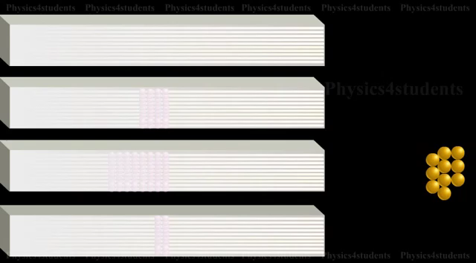

Slide 5
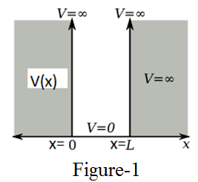
Prerequisite/Recapitulations
Course Code : BBS01T10
--
1. Schrödinger equation in one dimension is
2. The allowed energy for 1D potential box,
where m is mass of particle, L is the length of potential box and n are positive integers like 1, 2, 3, 4, 5....
The potential energy within the 1D crystal or box is
V(x) = 0 for o < x < L
V(x) = ∞ for x ≤ 0 and x ≥ L
3. Bloch’s Theorem
This is a mathematical representation regarding the form of one electron wave function for a perfectly periodic potential function with a period a.
According to Bloch's theorem, the wave function solution of the Schrödinger equation when the potential is periodic, V(x+a)=V(x) can be written as:
Where u(x) is a periodic function which satisfies:

Slide 6
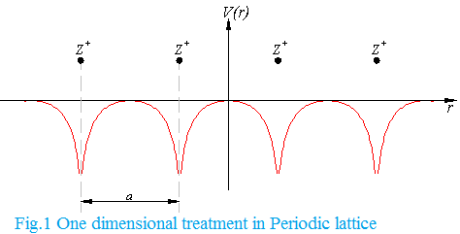
Introduction
The free electron theory is to take into account of the periodic potential with periodicity of the lattice.
Periodic potential arises due to periodic charge distribution associated with ion cores situated on the lattice sites plus the constant (average) contribution due to all other free electrons of the crystal.
For the motion of an electron in a crystalline solid we need to write Schrodinger equation for the electrons and find its solution under periodic boundary conditions.
The solution of Schrodinger equation was simplified by F. Bloch who realised the symmetry properties of the potential in which the electron in a crystalline solid moves.
The potential is periodic (except close to boundary atoms) and hence V(x+a)=V(x)

Slide 7
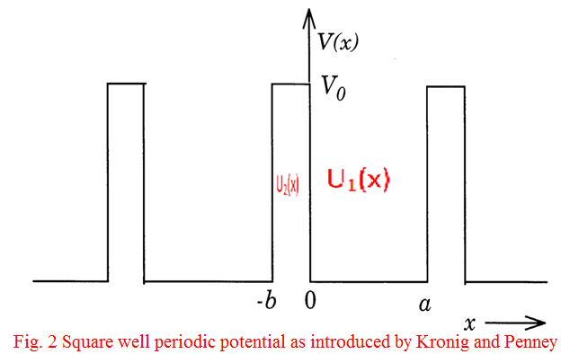
Kronig-Penney Model
For electron in a periodic potential it assumes that the potential energy of an electron forms a periodic square potentials of periods (a+b) such that
V(x) = V₀ for -b < x <0
= 0 for 0< x < a
This model, although idealised but very useful because it explains many useful periodic features of the behaviour of electron-lattices.
The wave functions associated with this model may be calculated by solving Schrodinger equations in two regions:

Slide 8
Kronig-Penney Model
As the potential is periodic, the wave functions must have the Bloch form
If u₁(x) and u₂(x) represent the values u(x) in two regions (0< x < a ) and (-b < x <0) of potential functions respectively, the equations (4a) and (4b) give
The solution of these equations may be written as
where A, B, C and D are constants and can be determined by the following boundary conditions
The first two conditions are due to requirement of continuity of wave function ψ and its derivative while the last two conditions are due to periodicity of u(x).

Slide 9
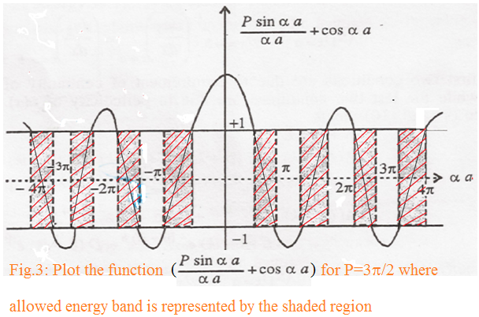
Kronig-Penney Model
:
Using boundary condition we can solve it to the condition for the solutions of the wave equation to exist
P is a measure of the quantity V₀b, which is the area of potential barrier, called barrier strength
where P=
Equation (7) is satisfied only for those values of αa for which left hand side lies between +1 and -1 this is because R.H.S must lie in the range +1 to -1. Such values of αa will, therefore, represent the wave like solutions and are accessible. The other values of αa will be inaccessible.
In Fig. 3, the part of the vertical axis lying between the horizontal lines represents the range acceptable. As α² is proportional to the energy E, the abscissa (αa) will be a measure of the energy
Clearly there are regions for αa where the value of does not lie between -1 and +1. For these values of αa and hence of energy E, no solutions exist. Such regions of energy are prohibited and are called forbidden bands.

Slide 10
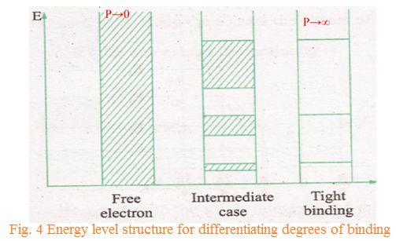
Energy bands in solids
:
The energy spectrum of the electron consists of alternate regions of allowed energy and forbidden energy
The width of the allowed energy band increases as the value of αa (i.e., energy) increases.
It is to be noted that P is a measure of the potential barrier strength.
Case 1: When P→∞, corresponding to a infinitely deep potential well, the electron can be considered as confined into a single potential well. This case applies to crystals where the electrons are very tightly bound
Equation (7) has the solutions only if sin αa = 0 or, αa = nπ,
This is the equation of energy levels of particle in a constant potential box of atomic dimension
This is the equation of energy levels of particle in a constant potential box of atomic dimension. The allowed energy bands are compressed into energy levels and the energy spectrum is a line spectrum (As in Fig.4).

Slide 11
Energy bands in solids
Case 2 : When P→0, corresponds to no barrier, the electron can be considered to be moving freely through the potential wells.
Case 3 : Between these two extreme limits, intermediate case, the position and the width of the allowed and forbidden bands for any value of P are obtained by drawing vertical lines in Fig. 5, the shaded areas corresponds to the allowed bands (Fig. 4 and Fig.5). Thus by varying P from zero to infinity we cover the whole range, from the completely free electron to the completely bound electron.
cos αa=cos ka i.e., α = k or α² = k²
E=
which is appropriate to the completely free particle.
.

Slide 12
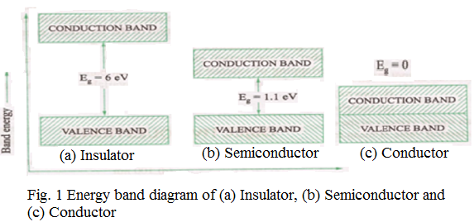
Classification of solids
Solids can be categorized into three main groups on the basis of band gaps as
Insulators
Semiconductor
Conductor.
A. Insulators
The forbidden energy gap (E_{g} ) is greater than 3eV
do not conduct electricity
number of electrons is just enough to completely fill a number of allowed energy bands.
Above these bands there exists a series of completely empty bands.
At ordinary temperatures electron can’t be thermally excited across this gap from the valence band to the conduction band.
As the bands are either completely filled or empty, no electric current flow.
The topmost filled band is known as the valence band
The lowermost empty band known as the conduction band
The gap between valence band and conduction band is known as forbidden energy gap (E_{g})
.

Slide 13
Classification of solids
Semiconductor
semiconductor exhibits an electrical conductivity intermediate between that of metal and insulators
the energy gap E_{g} is relatively small (of the order of 1eV).
an appreciable number of electrons can be thermally excited across the gap from the states near the top of the valence band to states the bottom of the conduction band.
As the temperature approaches absolute zero, the thermal excitation becomes vanishingly small and therefore all semiconductors behave as insulators at such temperatures.
.

Slide 14
Classification of solids
Conductor
Upper most energy band is partially filled or if the uppermost filled band and the next unoccupied band overlap in energy, the crystal is known as conductors (metal).
the electron in the uppermost band find adjacent vacant states to move into, by absorbing energy from an applied electric field. These electrons thus behave as free electrons and conduct electric currents.
The band gap E_{g} of a typical insulator, such as diamond is about 6eV while that of semiconductors lies in the range of 2 eV to 2.5eV and in conductor it is zero
.
The electrical conductivity of a metal, at room temperature, is of order of 10⁶mho/cm, that of semiconductor lies in the range 10³mho/cm to 10⁶mho/cm, and that of a good insulator is of order of 10⁻¹² mho/cm.

Slide 15
Practice Questions
What would be the band structure if the barrier strength is extremely negligible? Justify your answer with diagram.
What would be the band structure if the barrier strength is extremely high? Justify your answer with diagram.
3. Write down the Schrodinger’s equations for an electron moving in the periodic potential V(x)=0 for 0<x<a and V(x)= V₀ for –b<x<0. Solve the Schrodinger’s equations to obtain the condition for the existence of wave function
for E <<V₀ , V₀→∞ and b→0
4. Based on band theory of solids ,distinguish between conductors, semiconductors, and insulators . .

Slide 16
School of Basic and Applied Sciences
Course Code : BBS01T1002 Course Name: Semiconductor Physics
References
1. J. Singh , Semiconductor optoelectronics, Physics and Technology, Mc-Graw –Hill Inc. 1995.
2. S.M. Sze, Semiconductor Devices: Physics and Technology, Wiley 2008.
3. Pillai S O, Solid State Physics,( 2010), sixth edition, New Age International (P) Ltd. ISBN-9788122427264.
4. https://www.youtube.com/watch?v=okbCAdfKXoU
Name of the Faculty: Dr. Susmita Majumdar Program Name: B.Tech

Slide 17
School of Basic and Applied Sciences
Course Code : BBS01T1002 Course Name: Semiconductor Physics
Thank you
Name of the Faculty: Dr. Susmita Majumdar Program Name: B.Tech

